Slide 1


Slide 2





Multimedia Signal Processing Research Lab.

Slide 3
Feature Selection Based on Mutual Information:
Criteria of Max-Dependency, Max-Relevance and Min-Redundancy
Hanchuan Peng, Fuhui Long, and Chris Ding
AUGUST 2005
Multimedia Signal Processing Research Lab.

Slide 4
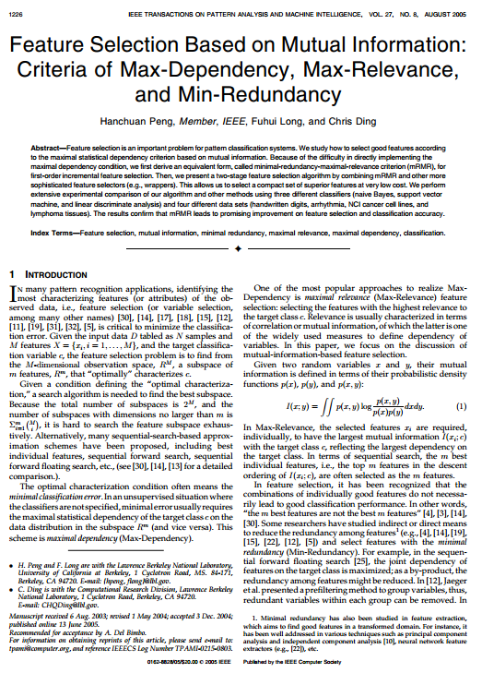
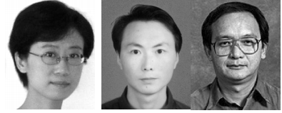
Multimedia Signal Processing Research Lab.

Slide 5
Maximal statistical dependency criterion based on mutual information
difficulty in directly implementing
maximal-relevance (1st Order mRMR)
minimal-redundancy
+
maximal-relevance
Multimedia Signal Processing Research Lab.

Slide 6




$$X=\{x_{i};i=1;...;M\}$$
$$R^{M}$$
$$R^{m}$$
$$m<M$$
Minimal classification error
Supervise
Maximal statistical dependency
with
c
Unsupervise
Maximal dependency
Multimedia Signal Processing Research Lab.

Slide 7
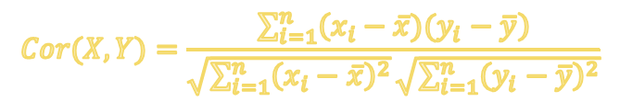
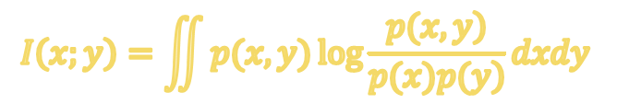
Maximal dependency
Maximal relevance
correlation
mutual information
$$Cor(X, Y)=\frac{\sum_{i=1}^{n}{\left(x_{i}−\overline{x})(y_{i}−\overline{y}\right)}}{\sqrt{\sum_{i=1}^{n}{{\left(x_{i}−\overline{x}\right)}^{2}}}\sqrt{\sum_{i=1}^{n}{{\left(y_{i}−\overline{y}\right)}^{2}}}}$$
$$I\left(x;y\right)=\iint{p(x,y)\log{\frac{\left.p(x,y\right)}{\left.p(x)p(y\right)}}dxdy }$$
Minimal redundancy
PCA
Multimedia Signal Processing Research Lab.

Slide 8

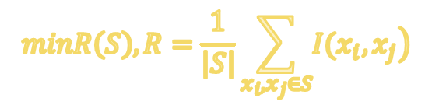
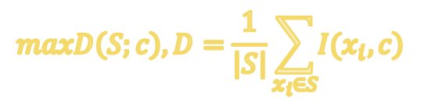
Max-Relevance
Min-Redundancy
$$maxD\left(S;c\right),D=\frac{1}{\left|S\right|}\sum_{x_{i}∈S}{\left.I(x_{i},c\right)}$$
$$minR\left(S\right),R=\frac{1}{\left|S\right|}\sum_{x_{i},x_{j}∈S}{\left.I(x_{i},x_{j}\right)}$$
$$max φ\left(D, R\right),φ=D−R$$
Multimedia Signal Processing Research Lab.

Slide 9
Selecting the Candidate Feature Set
Selecting Compact Feature Subsets
Characteristic Feature Space
Multimedia Signal Processing Research Lab.

Slide 10
Implementation Issues
Mutual Information Estimation
Multiple Classifiers
Multimedia Signal Processing Research Lab.

Slide 11
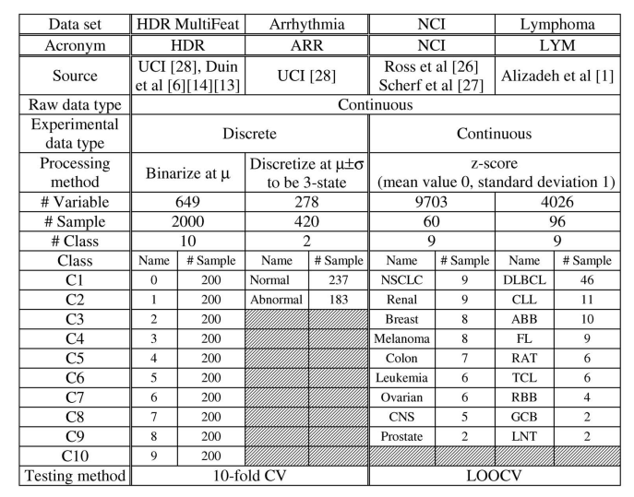
Multimedia Signal Processing Research Lab.

Slide 12
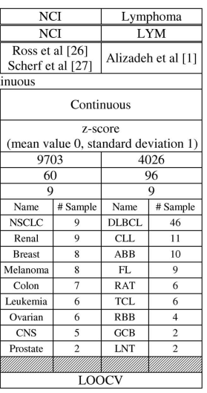
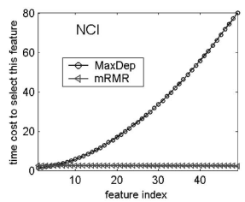
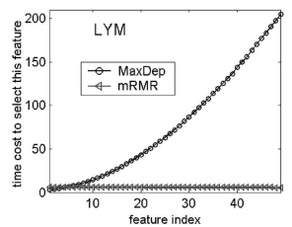
Multimedia Signal Processing Research Lab.

Slide 13
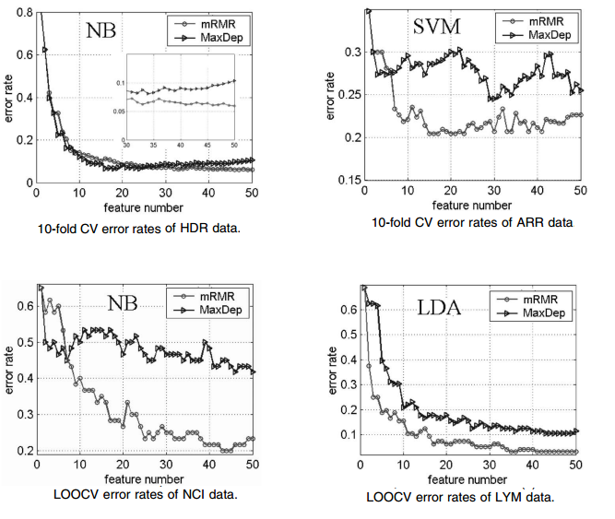
Multimedia Signal Processing Research Lab.

Slide 14
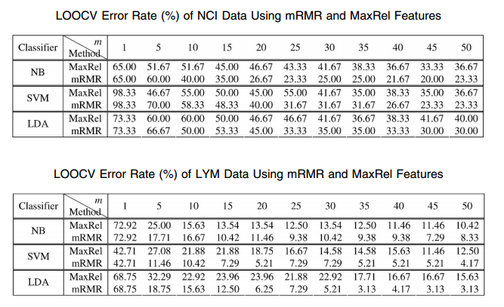
Multimedia Signal Processing Research Lab.

Slide 15
یادگیری آماری:
تدوین و تحقیق: محمد حسن شماخی
منابع:
[1] A.A. Alizadeh et al., “Distinct Types of Diffuse Large B-Cell
Lymphoma Identified by Gene Expression Profiling,” Nature,
vol. 403, pp. 503-511, 2000.
[2] C.J.C. Burges, “A Tutorial on Support Vector Machines for Pattern
Recognition,”Knowledge Discovery and Data Mining,vol. 2, pp. 1-43, 1998.
[3] T. Cover and J. Thomas,Elements of Information Theory.New York:
Wiley, 1991.
[4] T.M. Cover, “The Best Two Independent Measurements Are Not
the Two Best,” IEEE Trans. Systems, Man, and Cybernetics, vol. 4,
pp. 116-117, 1974.
[5] C. Ding and H.C. Peng, “Minimum Redundancy Feature Selection
from Microarray Gene Expression Data,” Proc. Second IEEE
Computational Systems Bioinformatics Conf.,pp. 523-528, Aug. 2003.
بهار 94
Multimedia Signal Processing Research Lab.

